Slide 1

Noida institute of Engineering & Technology
Department of CSE (AI)
Session (2023-24)
Mini Project (ACSE0659) Presentation on
“PRODUCT PRICE RECOMMENDATION”
Project Guide: Submitted To: Members:
Mr. Yaduvir Singh Mr. Amar Pal Yadav Aryan Singh Gautam (2201331520029)
Asst. Prof. CSE(AI) Mr. Praveen Kumar Ashish Kumar Prajapati (2201331520036)
Harshaksh Singh (2201331520059)

Slide 2

Presentation Outline
Introduction
Literature Review
Objectives
Methodology
Data Cleaning
Exploratory Data Analysis
Feature Engineering
Machine learning Modeling
ML web app development
Deployment Machine learning app
Result
Conclusion
References

Slide 3
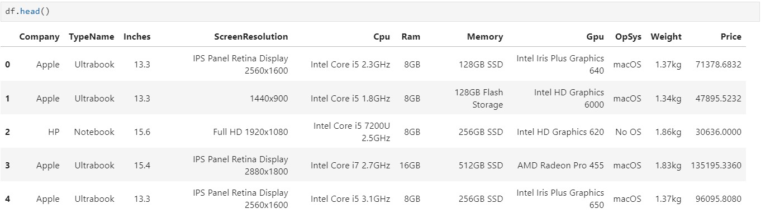
Introduction
Sellers and businesses can leverage your model to determine the optimal price for their products, thereby maximizing sales.
Problem Statement for Product Price Prediction
We will make a project for Laptop price prediction. The problem statement is that if any user wants to buy a laptop then our application should be compatible to provide a tentative price of laptop according to the user configurations. Although it looks like a simple project or just developing a model, the dataset we have is noisy and needs lots of feature engineering, and preprocessing that will drive your interest in developing this project.
About Dataset
This dataset contains Laptop prices , properties and configration of laptop , with a focus on price prediction. With a good amount of data on what price points sell the most, you can train machine learning models to predict the optimal price for a product based on its features and configrations.

Slide 4
Literature Review
In the modern business world, price prediction is most effectively supported by machine learning algorithms.
A literature review of product price recommendation projects reveals that these systems aim to provide optimal pricing strategies for products, taking into account factors such as market demand, competition, and profitability. These systems often employ machine learning algorithms to analyze historical sales data and predict the most effective prices for each product.
Machine Learning models, training ML algorithms on more data will provide more accurate answers than training on less data. Using statistical methods, algorithms are trained to determine classifications or make predictions, and to uncover key insights in data mining projects. These insights can subsequently improve your decision-making to boost key growth metrics.
Our study conducted a systematic review of recent contributions in the domain of recommender systems, focusing on diverse applications like books, movies, products, and more. The authors analyzed the algorithmic approaches used in each contribution and identified the datasets, simulation platforms, and performance metrics used. They also highlighted existing gaps and challenges in the field, such as scalability, cold-start, and sparsity.
Overall, the literature suggests that product price recommendation projects have the potential to significantly improve profitability and competitiveness for businesses, but also face challenges in terms of data quality, algorithmic complexity, and integration with existing systems.

Slide 5
Objective
Pricing the product has been one of the biggest challenges for companies. If you charge more, then fewer people would purchase the product and vice versa.
Economists say:
“that prices are determined by supply and demand. If the relative demand for a product increases, consumers will be willing to pay more for it. Their competitive bids will both oblige them individually to pay more for it and enable producers to get more for it.”
The objectives of the research work in the product price recommendation project are:
1. The uses of price prediction include increasing customer loyalty and engagement.
2. To develop a price recommendation system that can predict the optimal price for a product based on historical sales data and other relevant factors.
3. To improve the accuracy of the price recommendation system by applying various machine learning algorithms and hyperparameter tuning.
4. To analyze the correlation between different features and the target variable (price) to identify important features that can improve the performance of the model.

Slide 6
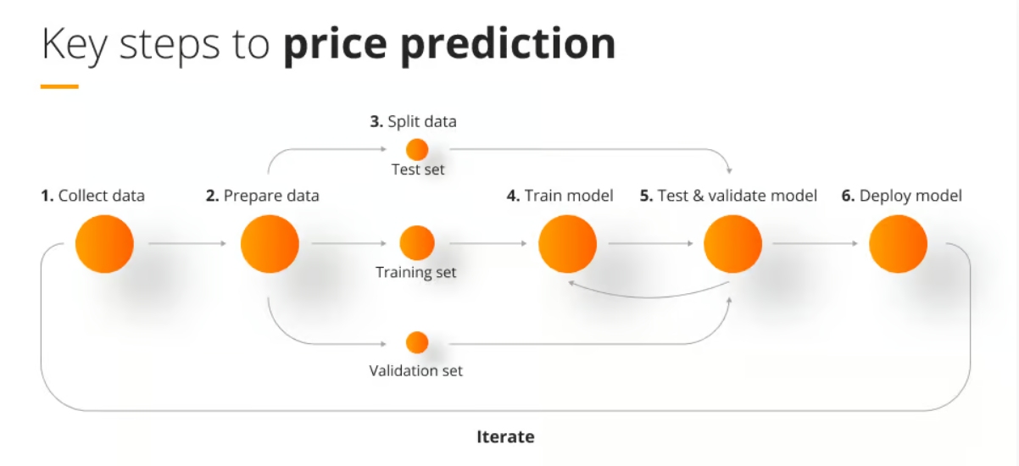
Methodology
Laptop Price Prediction – Machine learning project lifecycle
Data Cleaning
Exploratory Data Analysis
Feature Engineering
Machine learning Modeling
ML web app development
Deployment Machine learning app
Data Cleaning
The first step is to import the libraries and load data. After that we will take a basic understanding of data like its shape, sample, is there are any NULL values present in the dataset

Slide 7
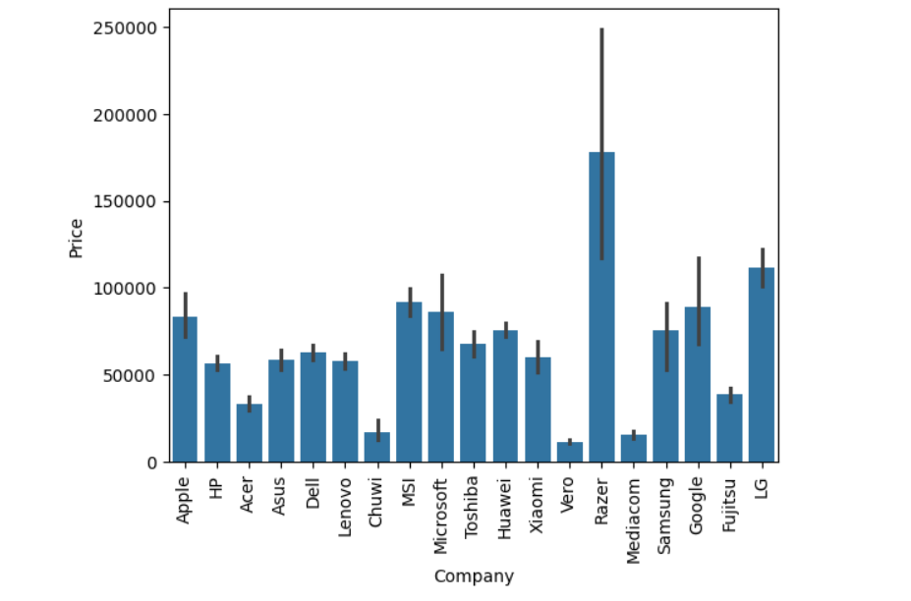
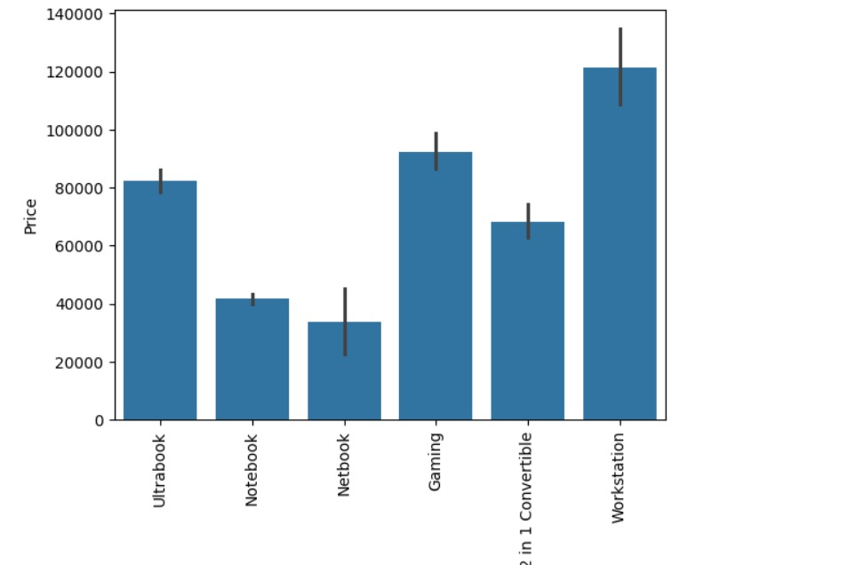
Methodology
EDA of Laptop Price Prediction Dataset
Exploratory analysis is a process to explore and understand the data and data relationship in a complete depth so that it makes feature engineering and machine learning modeling steps smooth and streamlined for prediction
1) Company column
we want to understand how does brand name impacts the laptop price or what is the average price of each laptop brand?
Price vs Company
2) Type of laptop
Which type of laptop you are looking for like a gaming laptop, workstation, or notebook. As major people prefer notebook because it is under budget range and the same can be concluded from our data.
Price vs Laptop type

Slide 8
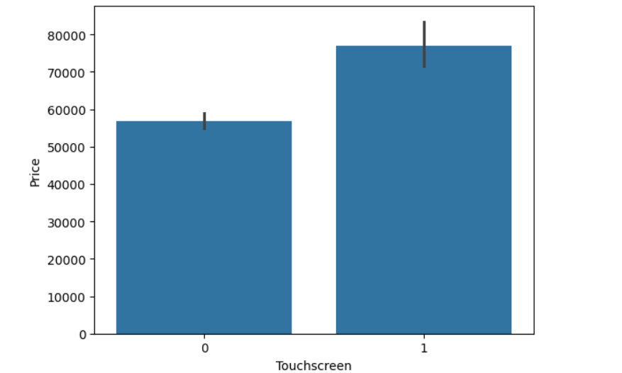
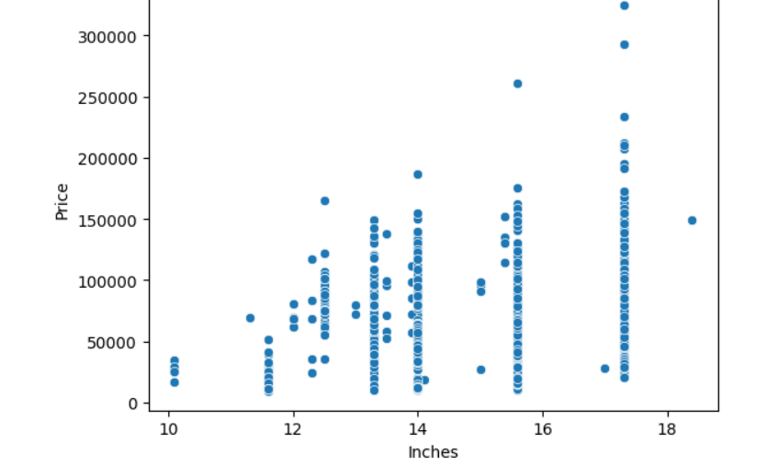
Methodology
Feature Engineering and Preprocessing of Laptop Price Prediction Model
Feature engineering is a process to convert raw data to meaningful information. there are many methods that come under feature engineering like transformation, categorical encoding, etc.
3) Screen Resolution
If you observe unique values of the column then we can see that all value gives information related to the presence of an IPS panel, are a laptop touch screen or not, and the X-axis and Y-axis screen resolution. So, we will extract the column into 3 new columns in the dataset.
Price vs Company
# Extract Touch screen information
# Extract IPS Channel presence information
# Extract X-axis and Y-axis screen resolution dimensions
# Replacing inches, X and Y resolution to Pixel per inches(PPI)

Slide 9
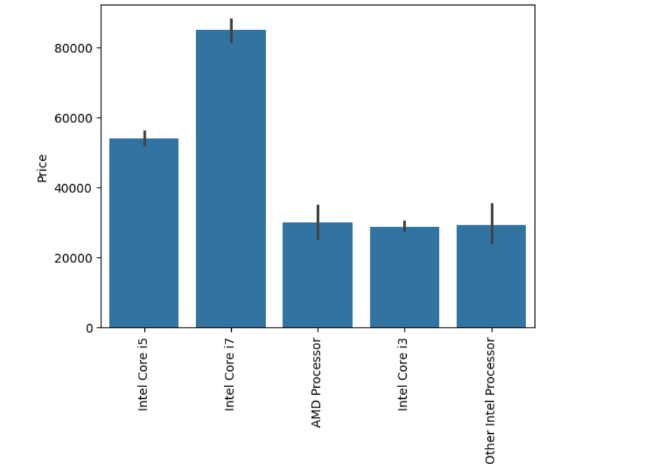
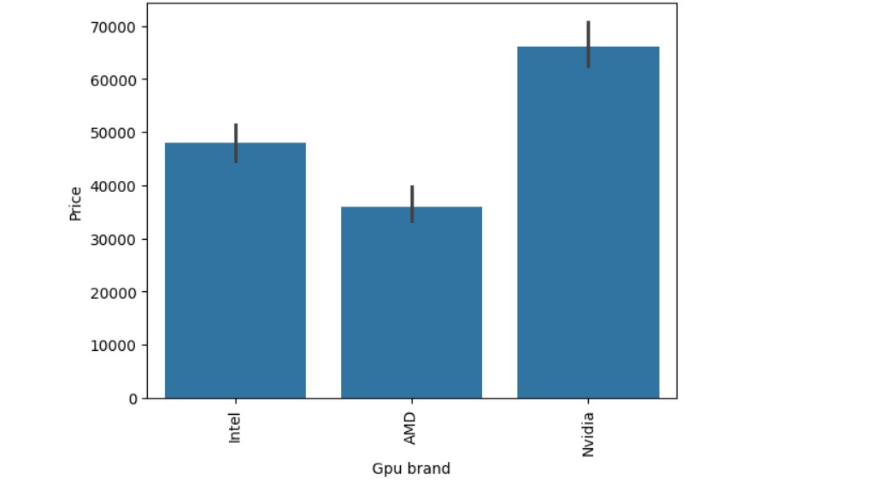
Methodology
4) CPU column
If you observe the CPU column then it also contains lots of information.we are having an Intel preprocessor and AMD preprocessor so we are keeping 5 categories in our dataset as i3, i5, i7, other intel processors, and AMD processors.
5) Price with Ram
Again Bivariate analysis of price with Ram.Price is having a very strong positive correlation with Ram
6) Memory and GPU column
We use value counts on a column then we are having 4 different categories of memory as HHD, SSD, Flash storage, and hybrid.
GPU(Graphical Processing Unit) has many categories in data.
so we will simply extract the name of the brand.

Slide 10
Methodology
Machine Learning Modeling for Price Prediction
Linear Regression
Ridge Regression
KNN
Decision Tree
Random Forest
Exporting the Model
We will save the pipeline object for the development of the project website. we will also export the data frame which will be required to create dropdowns in the website.
We use Pickle Library to do this
Create Web Application for Deployment of Model
Streamlit
Streamlit is an open-source web framework written in Python.
It is the fastest way to create data apps and it is widely used by data science practitioners to deploy machine learning models.

Slide 11
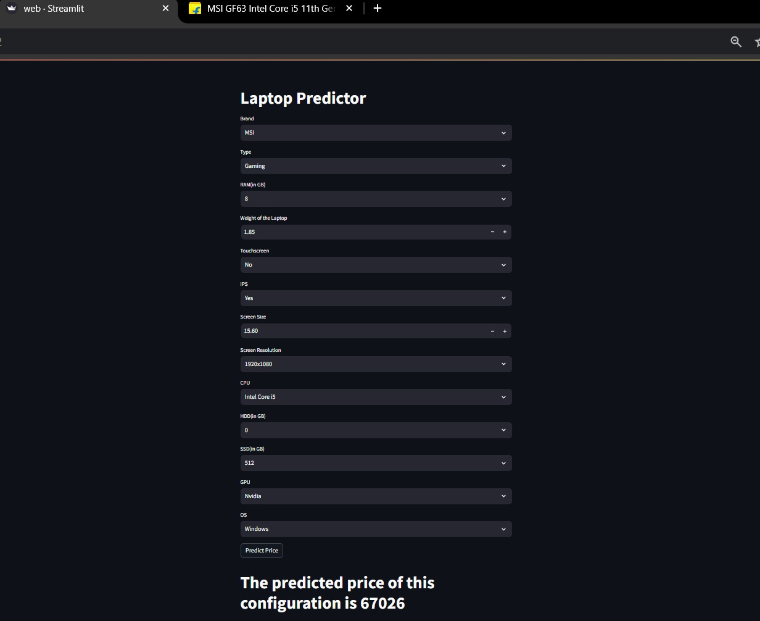

Result
When wou run the web file wou will get two URL and it will automatically open the web application in default browser
Random Forest has the highest R2 score for this Project
Model accuracy 89%

Slide 12
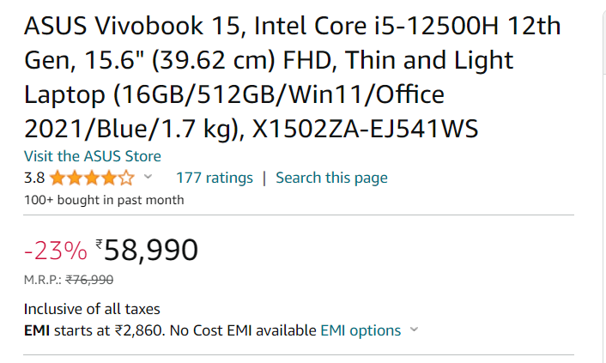
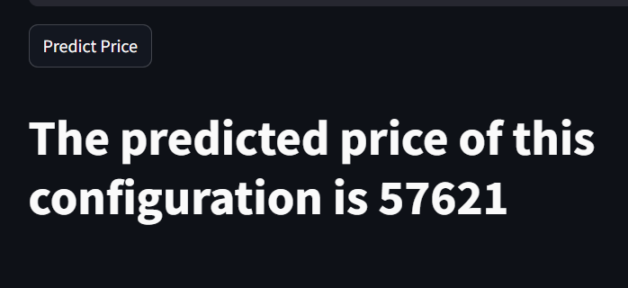
Conclusion
our product price recommendation project has provided a data-driven approach to determine the optimal price for [Laptop]. By analyzing market trends, competitor pricing, and cost structures, we recommend a price to achieve a balance between profitability and customer affordability."
we Achive the Model accuracy of About 89% using different machine learning model
Our Predicted price
Current price on Amazon

Slide 13
References
Here are some references:
Product Price Recommendation with LightGBM
Product Price Recommendation with Sentiment Analysis
Product Price Recommendation with Neural Networks
https://www.kaggle.com/datasets/asaniczka/usa-optimal-product-price-prediction/code
https://www.analyticsvidhya.com/blog/2021/11/laptop-price-prediction-practical-understanding-of-machine-learning-project-lifecycle/

Slide 14
Noida institute of Engineering & Technology
Thank you

